Slide 1

AJAX

Slide 2
Vue
<form>
@csrf
<div class="form-group">
<label for="nomFilm">Nom du film</label>
<input type="text" class="form-control" id="nom" value="{{ old('nom') }}" name="nom">
</div>
<div class="form-group">
<label for="anneeProduction">Année de production</label>
<input type="number" class="form-control" id="annee" value="{{ old('annee') }}" name="annee">
</div>
<div class="form-group">
<label for="description">Description</label>
<input type="text" class="form-control" id="description" value="{{ old('descrciption') }}" name="description">
</div>
<button class="btn btn-primary" id="ajaxSubmit">AJOUTER AJAX</button>
</form>

Slide 3
Ajouter une toast dans la vue
<div class="toast" role="alert" aria-live="assertive" aria-atomic="true" id="ajoutSucces" data-autohide="false">
<div class="toast-header">
<strong class="mr-auto">FILM ALERT</strong>
<small class="text-muted">il y a 5 secondes</small>
<button type="button" class="ml-2 mb-1 close" data-dismiss="toast" aria-label="Close">
<span aria-hidden="true">&times;</span>
</button>
</div>
<div class="toast-body">
Le film a été ajouté correctement
</div>
</div>

Slide 4
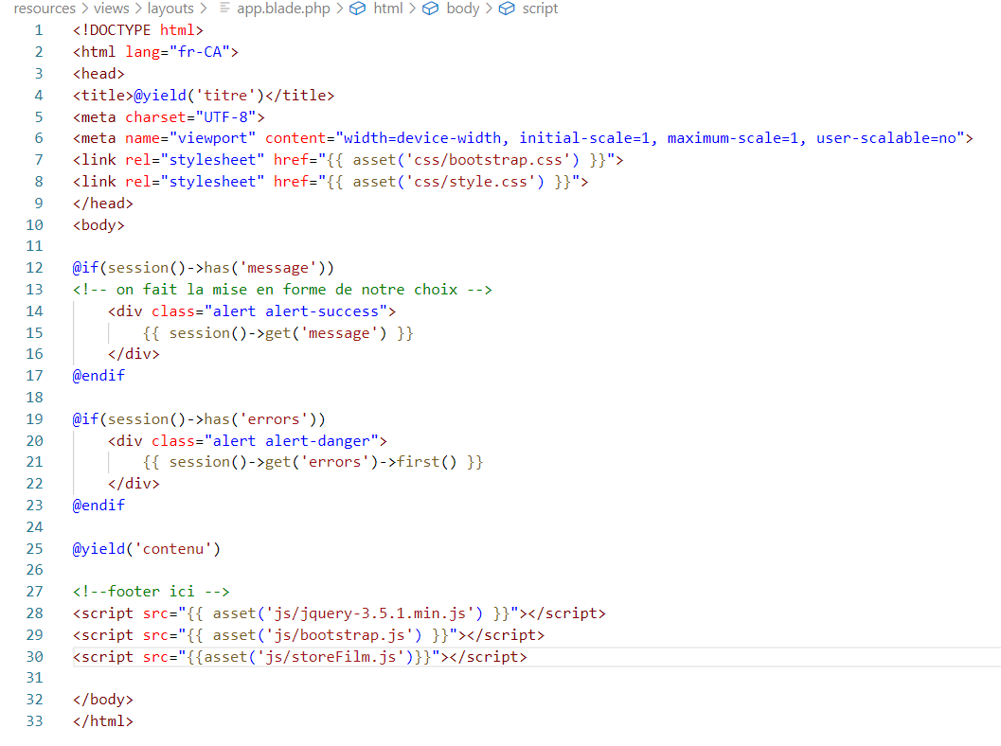
Gabarit

Slide 5
$(document).ready(function(){
$('#ajaxSubmit').click(function(e){
e.preventDefault();
var _token = $("input[name='_token']").val();
var nom = $("#nom").val();
var annee = $("#annee").val();
var description = $("#description").val();
$.ajax({
url: "ajouterPOST",
type:'POST',
data: {
_token:_token,
nom:nom,
annee:annee,
description:description
},
success: function(data) {
if(data === "reussi"){
$('#ajoutSucces').toast('show');
}
},
error: function (xhr, ajaxOptions, thrownError) {
alert(xhr.status);
alert(thrownError);
}
});
});
});

Slide 6
Avec photos
$(document).ready(function(){
$('#ajaxSubmit').click(function(e){
e.preventDefault();
var formData = new FormData();
formData.append("_token", $("input[name='_token']").val());
formData.append("nom", $("#nom").val());
formData.append("annee", $("#annee").val());
formData.append("description", $("#description").val());
formData.append('image', $('input[type=file]')[0].files[0]);
$.ajax({
url: "ajouterPOST",
type:'POST',
contentType: false,
processData: false,
data: formData,
success: function(data) {
if(data === "reussi"){
$('#ajoutSucces').toast('show');
}
},
error: function (xhr, ajaxOptions, thrownError) {
alert(xhr.status);
alert(thrownError);
}
});
});
});

Slide 7
Exercices
Modifiez l’ajout d’un acteur pour que la commande s’effectue en AJAX.

